Slide 1
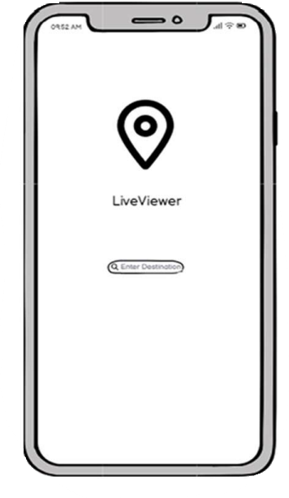
LiveViewer
CS335 Group 49
Chikezie Ogbogu
Brooklyn Igbojionu
Kian Sharma

Slide 2
What is LiveViewer
LiveViewer will be an application that enables users to plan transportation ahead of time, each trip will be
personalized to each user and ensure they can arrive at there destination in a timely fashion.

Slide 3
Features
LiveViewer offers real-time tracking of transportation services like buses and trains for accurate journey time estimates.
It factors in user wait times for different transport services to provide timely alerts on delays or early arrivals.
Users can compare routes with similar trips to find the fastest option for their destination at any given hour.
Push notifications remind users when it's time to leave based on their habits, ensuring timely arrivals.
For areas public transport doesn't cover, Last Mile Ride-Sharing connects users traveling to the same place to share taxis or private cars, reducing costs.

Slide 4
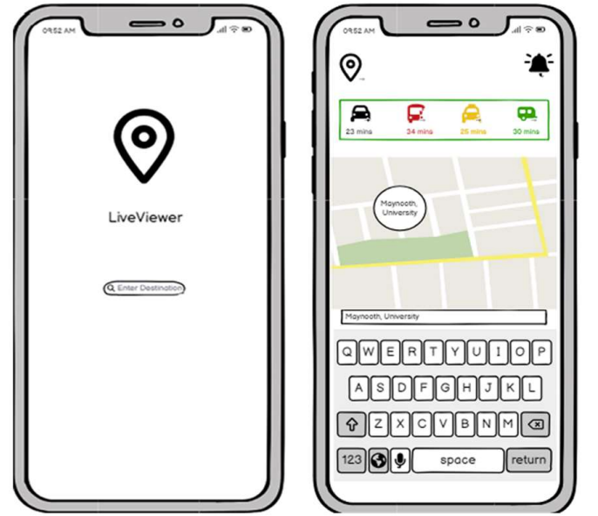
Home Screen
You start off by entering your destination.
The app will then show estimates on how long each form of transport will take.

Slide 5
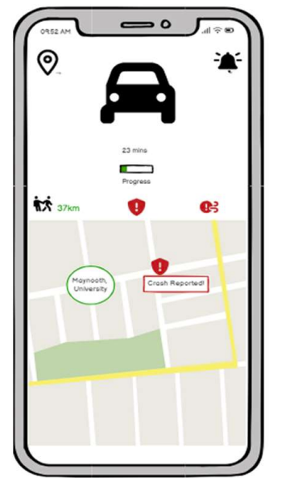
Traffic Report
The app will then present you with detailed information about the current traffic conditions, weather etc and will notify you about changes live.

Slide 6
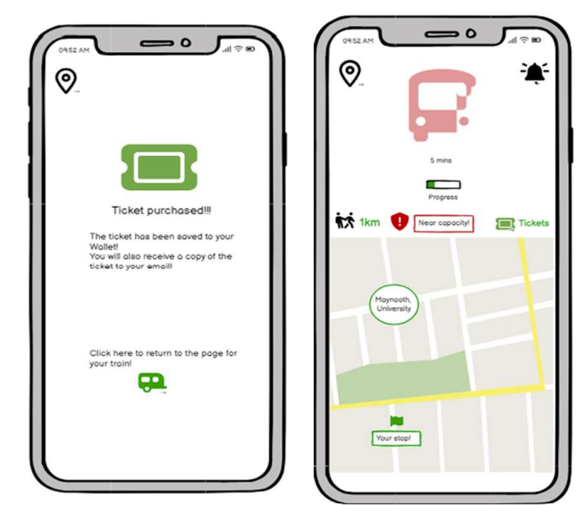
How LiveViewer adapts to you
LiveViewer allows you to purchase tickets from the app while also giving you information about the transport mode you are using it.

Slide 7
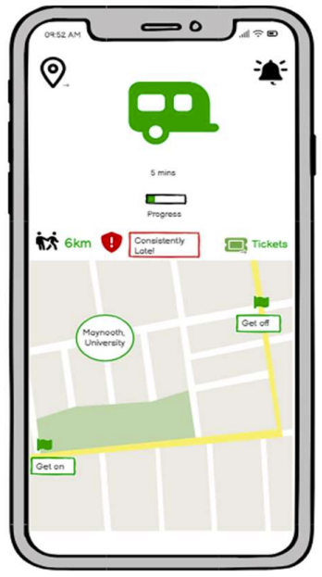
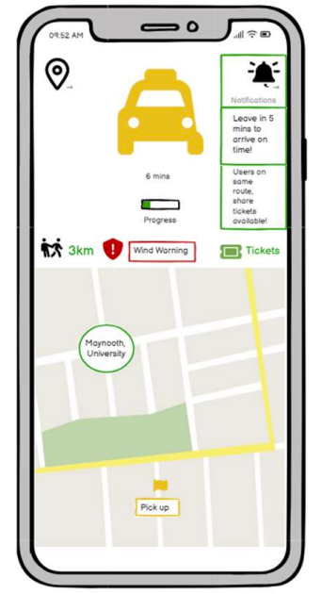
How LiveViewer adapts to you
It also tracks you and how late you are to your location then adapts to you.
It does that by using alerts and reminders to help and recommending earlier transport.

Slide 8
System Tests
1. Shortest Route
Test the accuracy of the system in calculating the shortest route based on a user’s inputted location. Test the system’s ability to respond in real time to events such as crashes, traffic, and delays, and notify and redirect the user based on this information. Test the system to ensure it is recommending the fastest route available to the user first, irrespective of pricing.
2. Carbon Footprint
Test the systems to ensure that it is recommending environmentally friendly means of transport to the users inputted destination. Test the accuracy and validity of the information the system is acting upon.
3. Weather
Test the system’s ability to recommend routes based on real time weather information and recommend more suitable means of travel depending on the weather, based on the users destination. Test the accuracy and validity of the systems recommendations and weather information.

Slide 9
System Tests
4. Busy Times
Test the system’s ability to adapt to changing circumstances based on time, and notify and redirect users from busy or late means of transport based on the users inputted route Test the system to ensure the system is accurately keeping track of wait times, delays, and busy times of day.
5. Ride Share
Test the system’s ability to find and group users who have inputted a rural, hard to reach destination and recommend them a shared means of travel to their respective locations based on the users’ input. Test the system to ensure it is recommending an efficient route for all grouped users and providing them with the means to contribute collectively to lower costs for each respective individual. Test the system to ensure the accuracy and validity of the users and routes it is grouping together, and ensure the efficiency of the shared route for each user.

Slide 10
Contributions
Chikezie Ogbogu
Diagrams for User Stories 6-10, Power point
Brooklyn Igbojionu
User Stories, Diagrams for User Stories 1-5, Video
Kian Sharma
Wireframes

